Slide 1
Trafficking cables

Slide 2
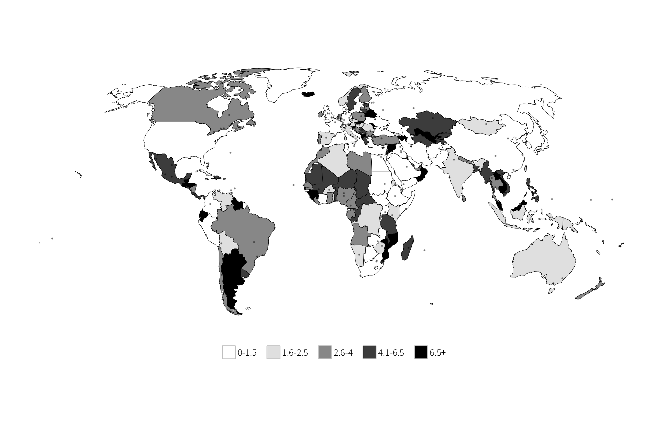
TIP-related cables per 1,000 estimated cables (adjusted average TIP effort)

Slide 3
Funding

Slide 4
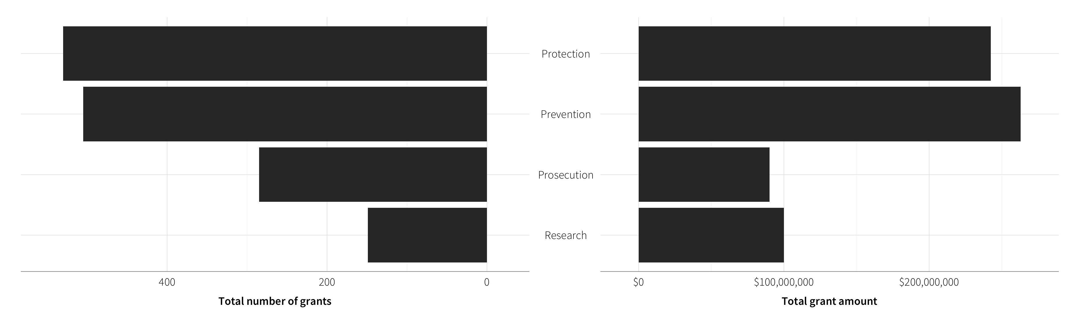
Purpose of grants awarded to IGOs

Slide 5
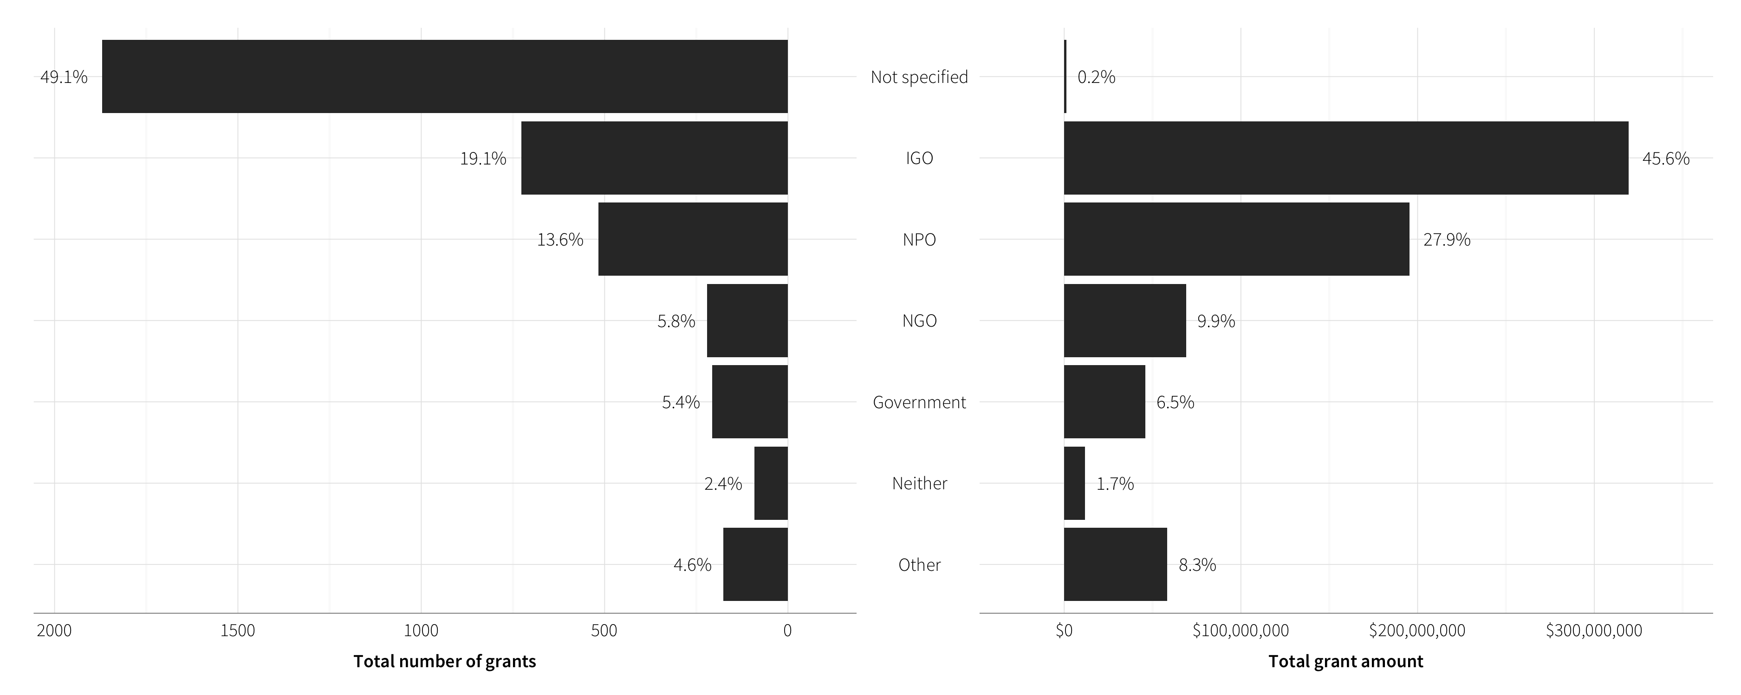
Grants awarded to all sectors
“Other” includes Academic Fellowship, Individual, Private Firm, Think Tank, and University

Slide 6
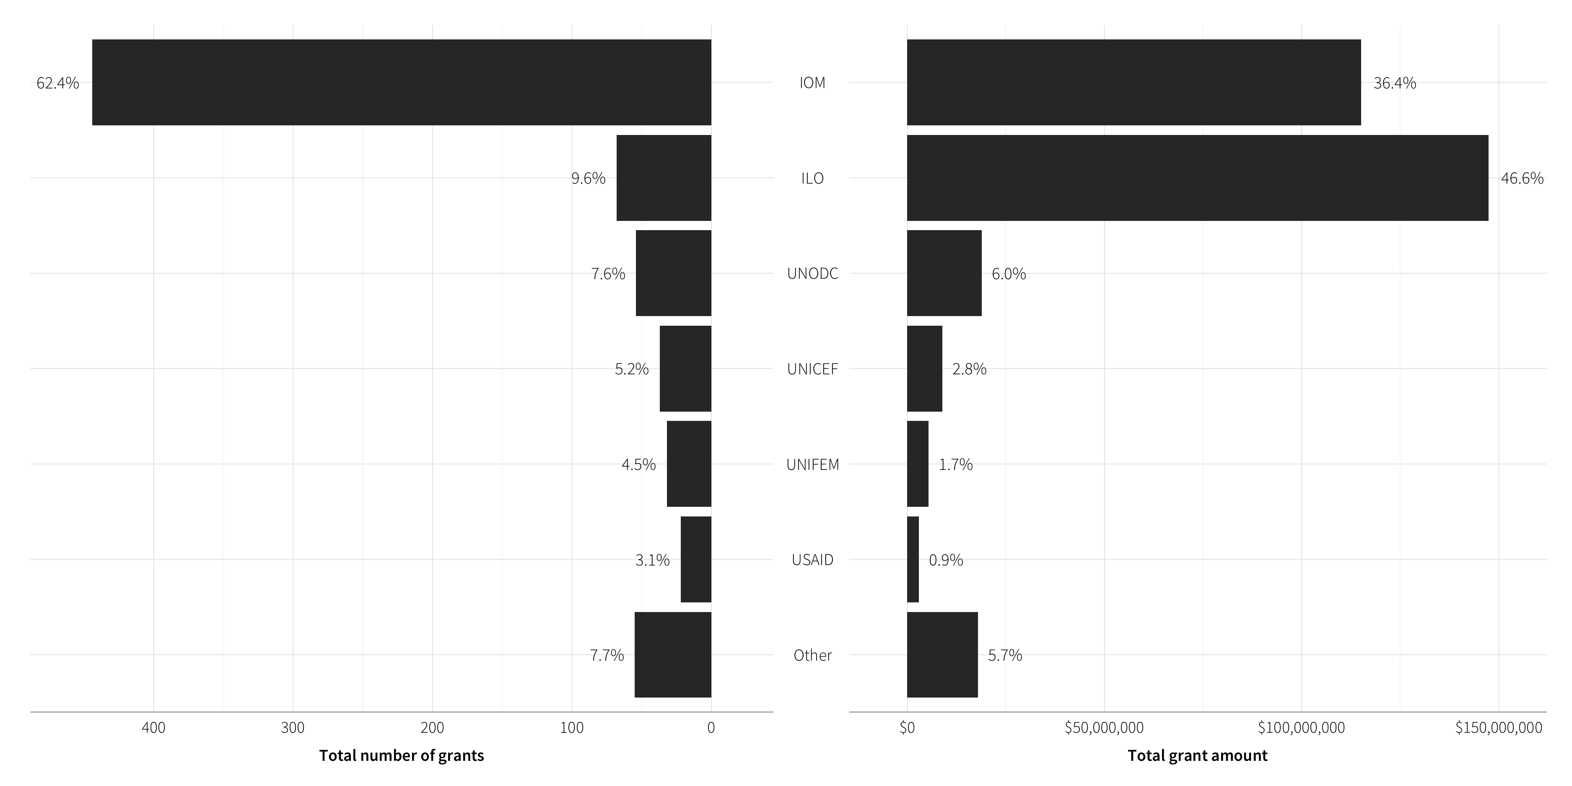
Grants awarded to IGOs
“Other” includes ASEAN, ECOWAS, ICITAP, ICMPD, ILEA, IO, IRC, OAS, OHCHR, OSCE, UN, UNDP, UNDPKO, and UNIAP

Slide 7
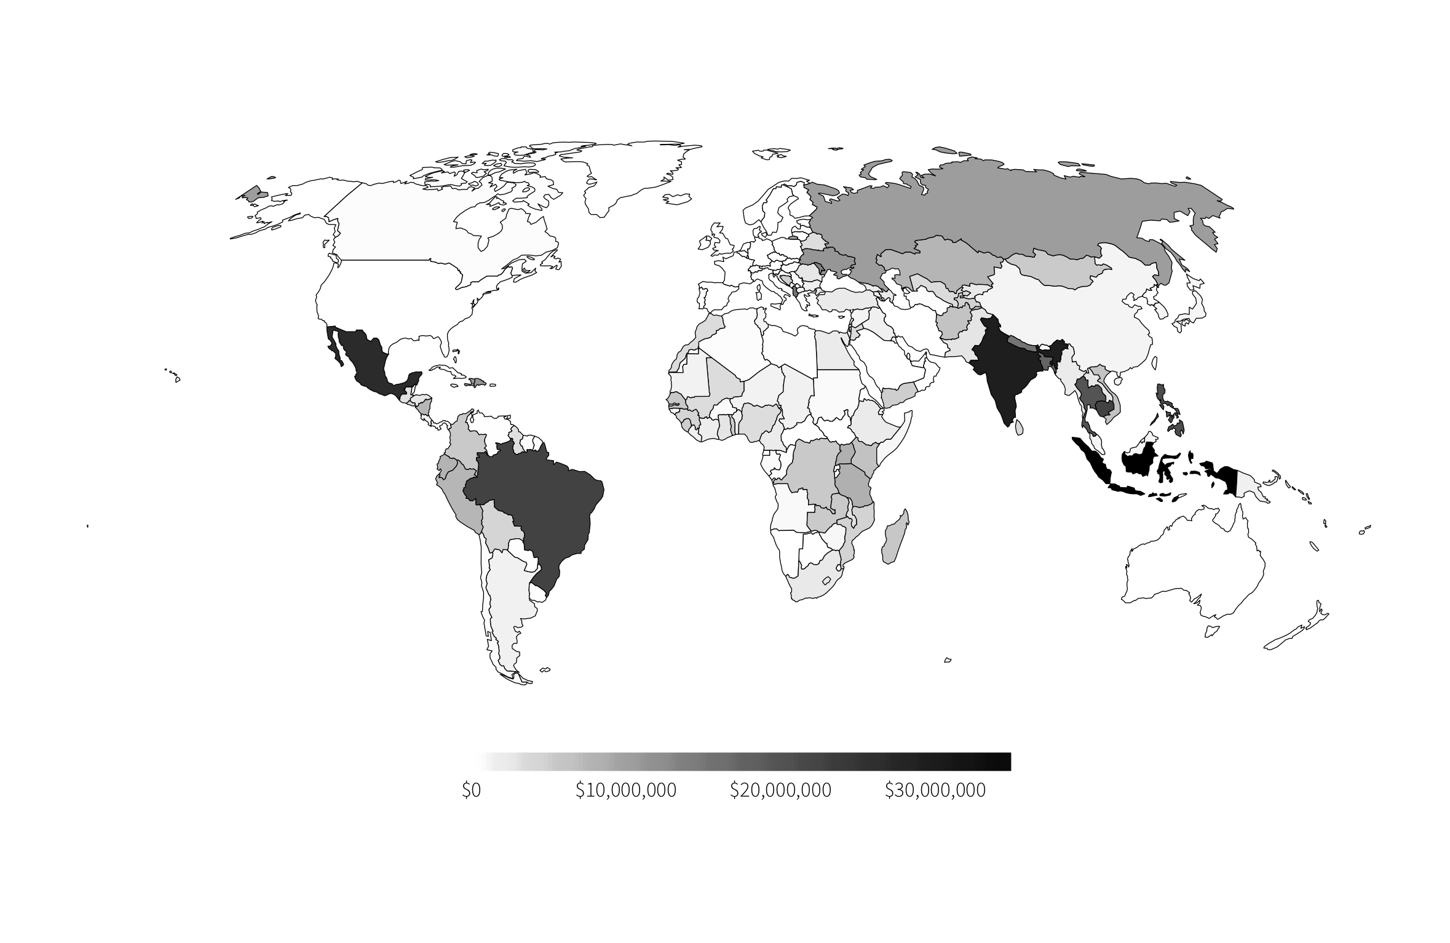
Total anti-TIP funding

Slide 8
Criminalization

Slide 9
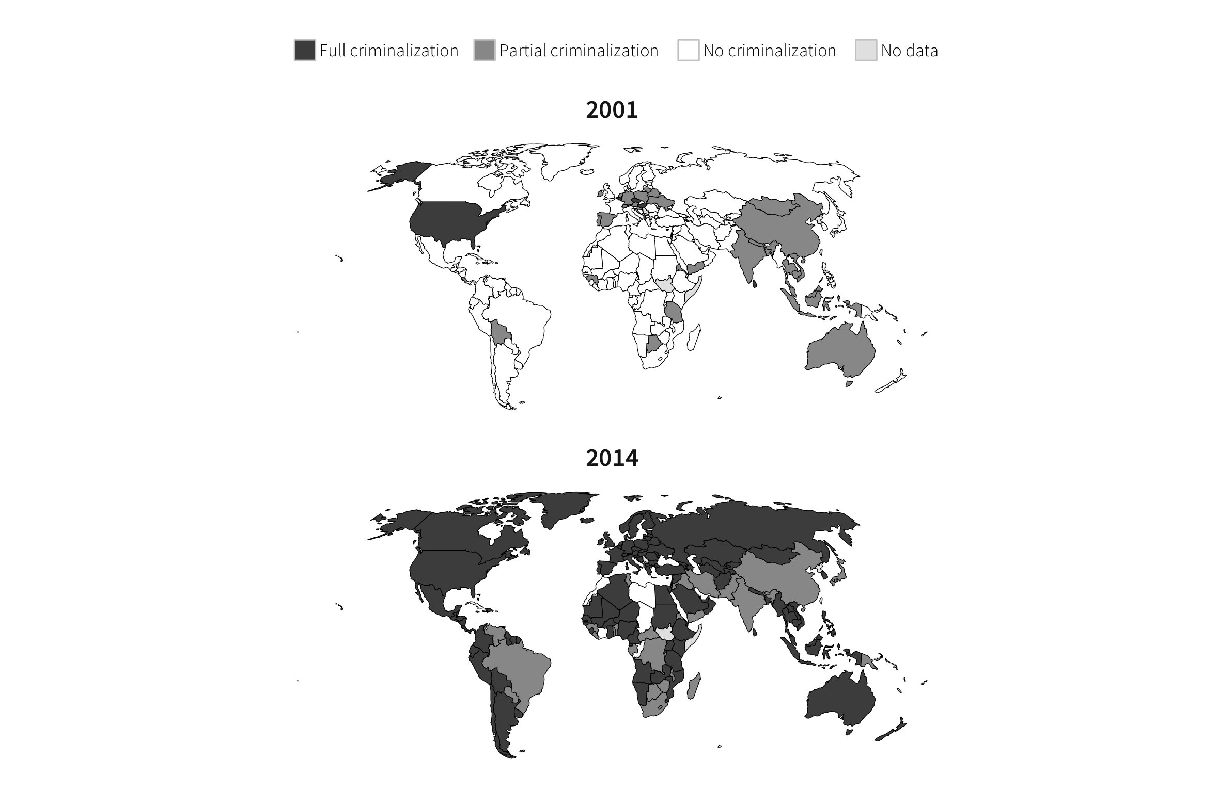
TIP criminalization

Slide 10
Trafficking flows

Slide 11
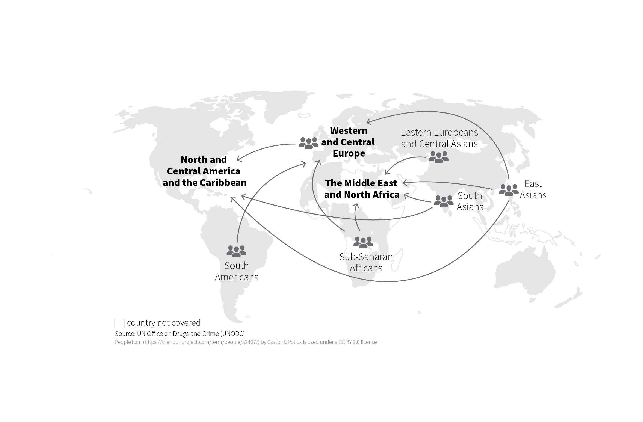
Main destination areas of transregional trafficking flows and their significant origins, 2010–2012
Arrows show the flows that represent 5% and above of the total victims detected in destination subregions

Slide 12
Inclusion in TIP report

Slide 13
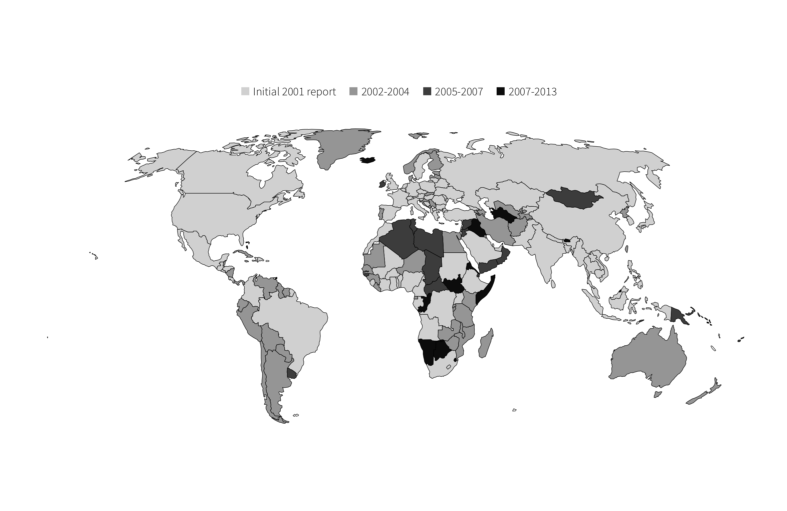
Year added to TIP report

Slide 14
Tier information

Slide 15
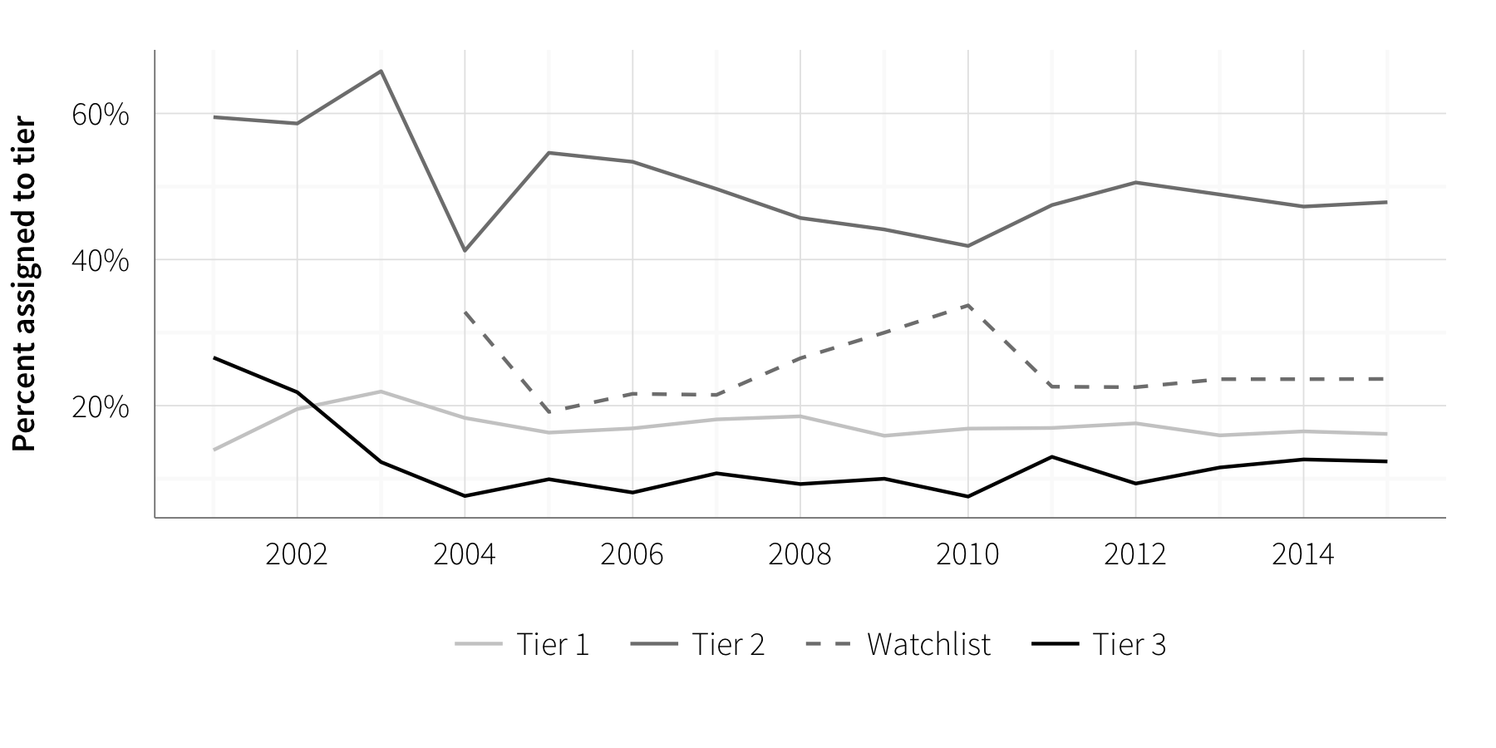
Distribution of tier assignments

